Slide 1
Junit 3.8.1
In 1997, Erich Gamma and Kent
Beck created a simple but effective unit testing framework for Java, called JUnit.

Slide 2
Junit technology use java reflection technology to accomplish its work
Separate classloaders for each unit test to avoid side effects.
Standard life cycle (setUp and tear-Down).
A variety of assert methods to make it easy to check the results of your tests.
We start with writing TestCase
The purpose put more test method in a single TestCase class it to share life cycle methods. Nothig else.
If want to run several TestCase at as a bunch we use TestSuite and also otherTestSuite
TestSuite is executed by TestRunner

Slide 3
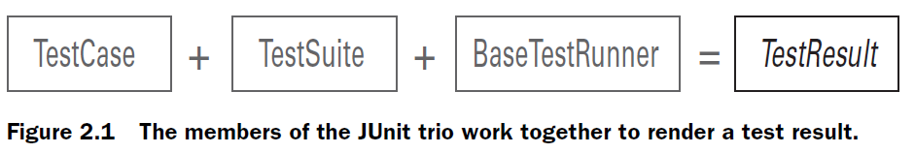

Slide 4
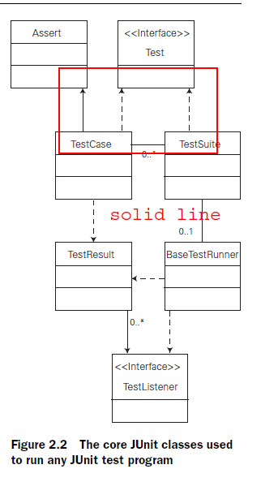


Slide 5
Begin
( TestRunner )
Create TestSuite
Create TestResult
Execute any test methods
end

Slide 6
Type of test
Method wise
Flow among all layer
Unit Test
Use case
Integration Test
Functional Test
Load / Stress Test
Acceptance Test

Slide 7
Unit Test need some other object or services or other environment
Stub
cactus
HttpUnit
Mock object
Even, we can develop mock object ourselves, there are framework. So using of either Cacatus or any Mock object framework, developer has to learn set of API
MockMaker
EasyMock
DynaMock
DBUnit
In CITCO project EasyMock used while test
Service layer. For DAO layer Spring’s support
Used.

Slide 8
Simply write one test case to check either database running or not to avoid any panic errors while deployment.
It will make sure all the resource are running and ready to demo in front of clients.
This will make tension free !!!

Slide 9
When study Junit Mock Object / Stub / Cactus framework, I will get more knowledge about how container works and how different low level code works for my J2ee Component

